Slide 1
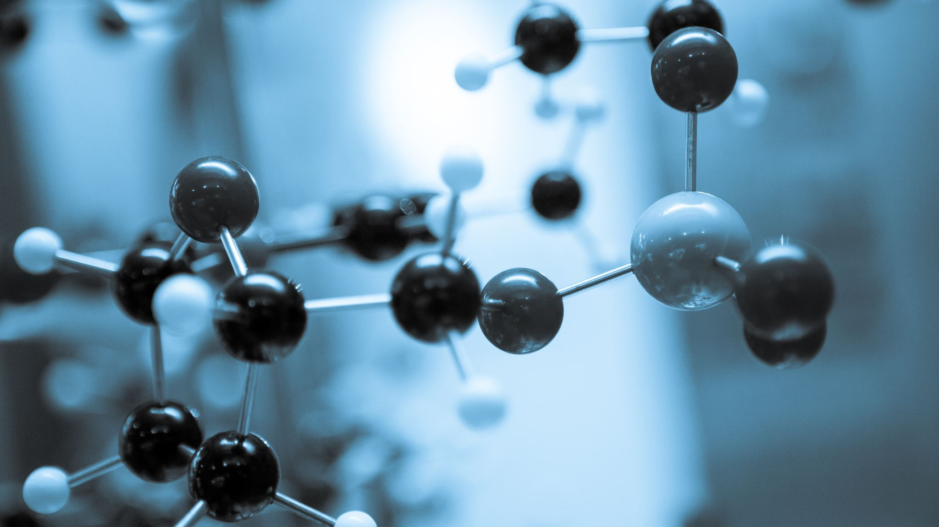
VCE SCIENCE

Slide 2
Biology
Chemistry
Physics
Environmental Science
Psychology

Slide 3
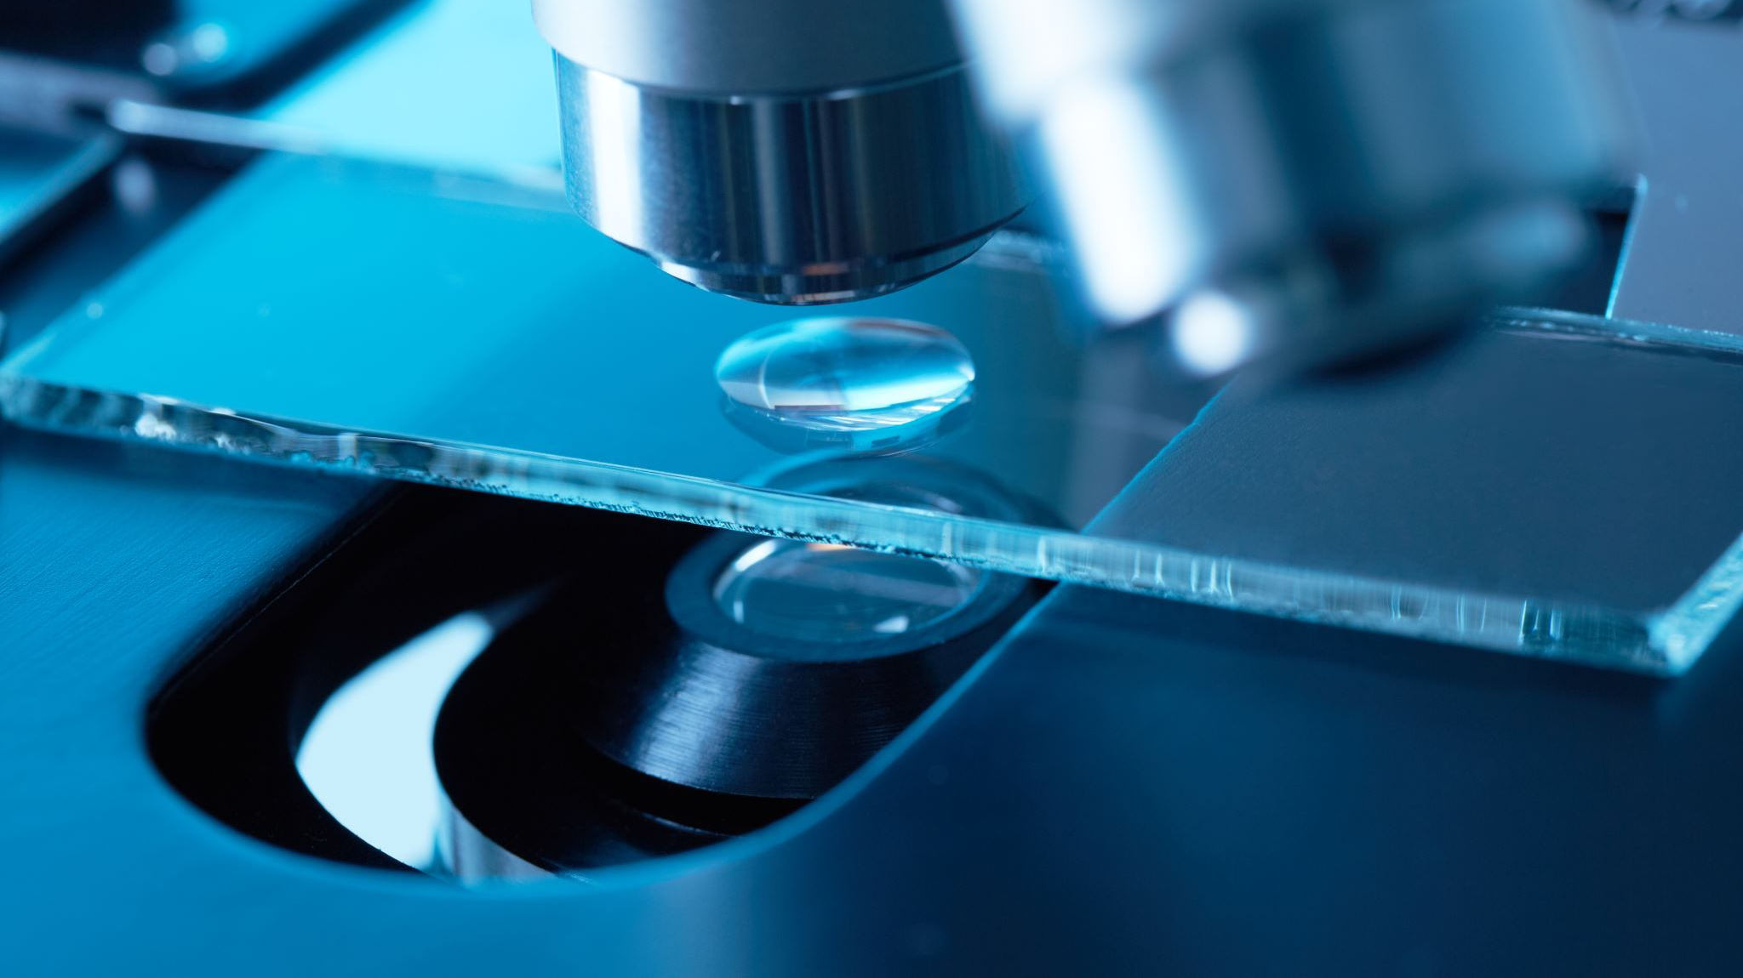
BIOLOGY

Slide 4

VCE Biology
Cells
Plants
Animals
Systems – Digestive, Excretory, Endocrine
Inheritance – Genes, Chromosomes
Reproduction - Cloning

Slide 5
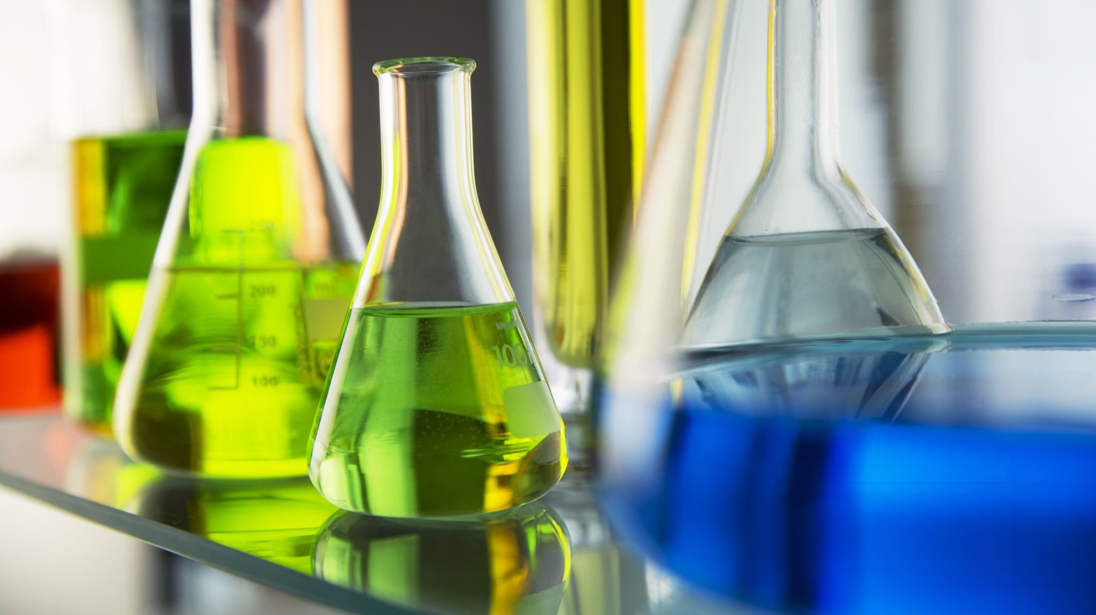
CHEMISTRY

Slide 6
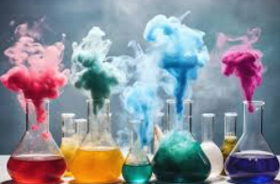
VCE Chemistry
Atoms
Periodic Table
Bonding – Ionic, Covalent and Metallic
Equations
Solubility
Stoichiometry
Organic Chemistry
Acids and Bases
Redox Chemistry

Slide 7

PHYSICS

Slide 8
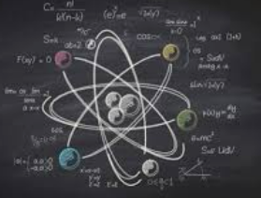
VCE Physics
Waves
Electromagnetism
Light
Temperature and Heat
Nuclear Energy
Electricity
Circuits
Motion
Forces

Slide 9
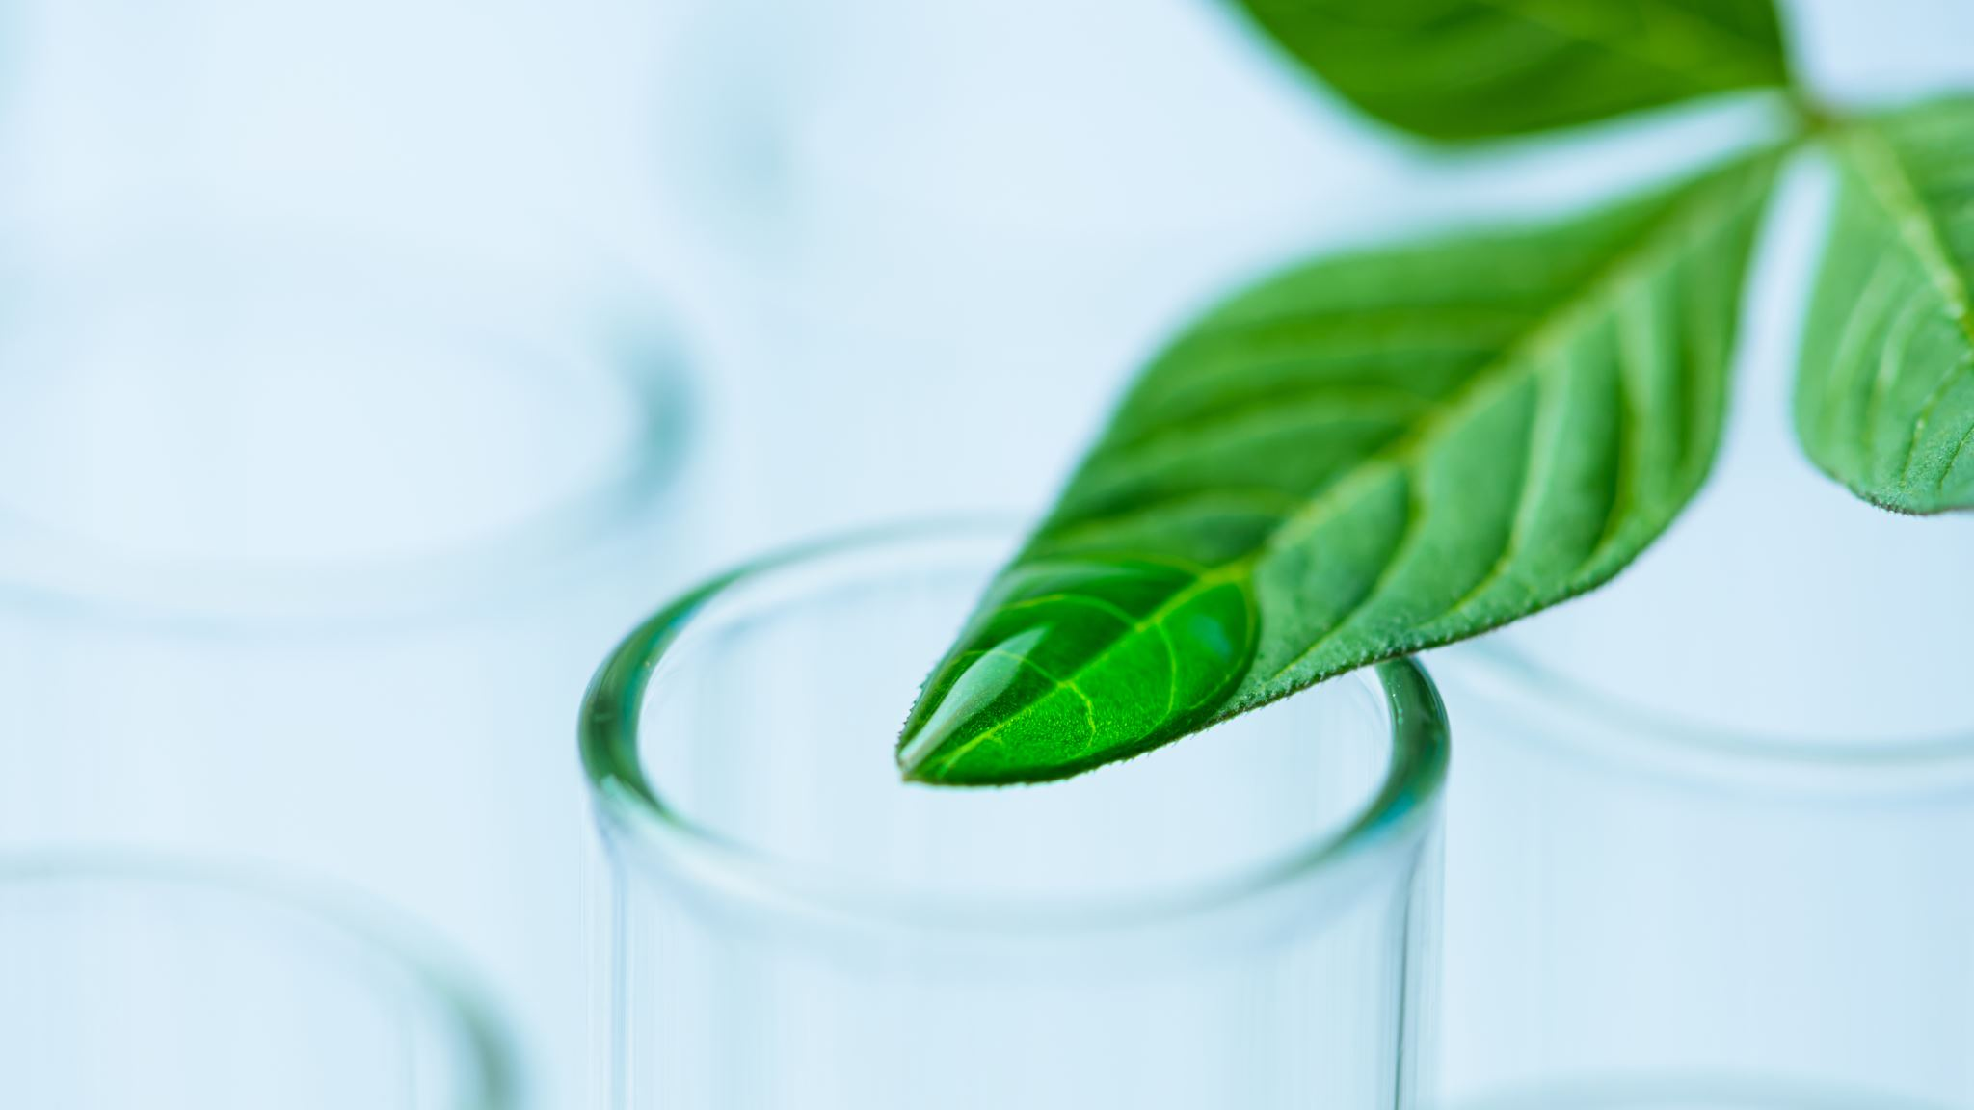
ENVIRONMENTAL SCIENCE

Slide 10
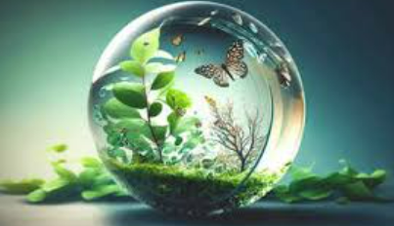
VCE Environmental Science
Earth’s Systems – Atmosphere, Biosphere, Hydrosphere, Lithosphere
Landscapes
Ecosystems
Biomes
Pollution
Food Systems and Security

Slide 11

PSYCHOLOGY

Slide 12

VCE Psychology
Psychological Development
Behaviour
The Brain
Mental processes
Attention
Perception

Slide 13
Please find more detailed information in the
VCE Science Handbooks
wiki space.

