Slide 1
VCE Physical Education & Outdoor Education

Slide 2
OUTDOOR EDUCATION

Slide 3

Unit 1: Connections with Outdoor Environments
How to know your environment
Environmental and natural history
Ecological, social and economic perspectives
Features of Biomes
Factors affecting biomes
Types of biomes in Australia and around the world
Motivations/Experience/Responses to the outdoors
Recreation
Connections
Exploration of the outdoors
Influence of depictions of experiencing the outdoors
Access to the outdoors
Technologies and their influences to participation in the outdoors
Risk vs reward
Safe and sustainable participation in the outdoors
Risk management
First aid
Safety equipment

Slide 4

UNIT 2: Discovering outdoor environments
Understanding outdoor environments
Scientific
Indigenous
Work/Vocational
Observing impacts on outdoor environments
Safe and sustainable interactions with outdoor environments
Community based environmental action
Impacts of technology
Urbanisation
Management of threatened species
Independent participation in outdoor environments
How to conduct sage and sustainable peer led experiences
How to plan and adapt outdoor experiences
How to monitor impact on the outdoors

Slide 5

Unit 3: Relationships with outdoor environments
Changing human relationships with the outdoors
Australia before humans
Indigenous relationships with the outdoors
Environmental movements in Australia
Relationships with Australian environments in the past decade
Custodianship
Conflicts
Policies
Social issues

Slide 6

Unit 4: Sustainable Outdoor Environments
The importance of healthy outdoor environments
Sustainability
Characteristics of outdoor environments
Impacts at local, national and international level to climate change
Future of outdoor environments
Acts or conventions related to management and sustainability
Investigating outdoor environments
plan for and conduct an independent investigation into a range of outdoor environments

Slide 7
Physical Education

Slide 8
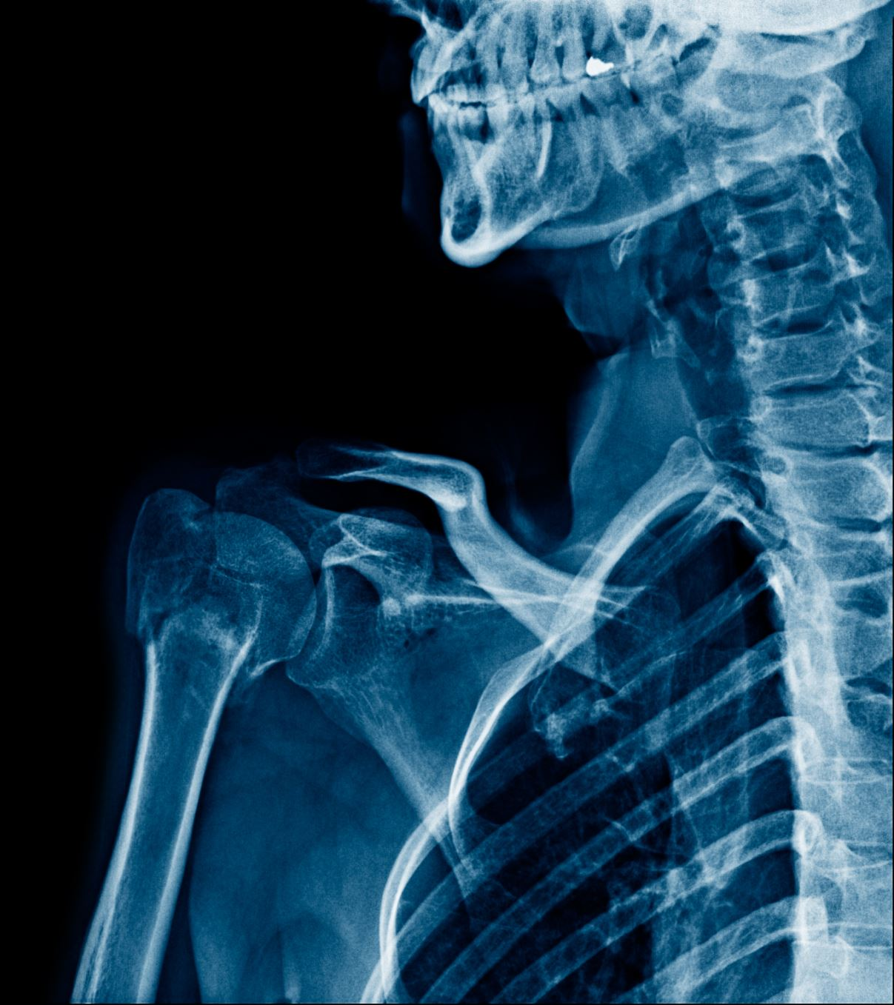
Unit 1: The Human Body
AOS 1: Structure and function of musculoskeletal system
  Injuries and illnesses of the musculoskeletal system
  Performance enhancement of the musculoskeletal system
AOS 2: Structure and function of cardiorespiratory system
  Enhancing performance of the cardiorespiratory system

Slide 9

Unit 2: Physical Activity and factors effecting it.
AOS 1:
Physical activity and sedentary behaviour: sociocultural influences, enablers and barriers
Strategies to increase physical activity and reduce sedentary behaviour
Promoting physical activity through a personalised plan

Slide 10

Unit 2: Physical Activity and factors effecting it.
AOS 2:
Intrapersonal issues
Hormonal considerations
Injuries
Psychological skills
Mental fitness/training
Interpersonal issues
Geographic location
Coaching
Socioeconomic status
Technology and media
Gender equity

Slide 11
Unit 3: Movement, Coaching, Biomechanics
AOS 1:
Movement skills
Classification of movement skills
Motor skill development
Participation and performance
Coaching and feedback
Stages of learning
Styles of coaching
Types of feedback
Performance enhancement

Slide 12

AOS 1 cont’d
Biomechanics
  Linear and angular concepts of movement
  Newtons laws of motion
  Levers
  Projectile motion
  Balance and equilibrium
  Movement analysis

Slide 13
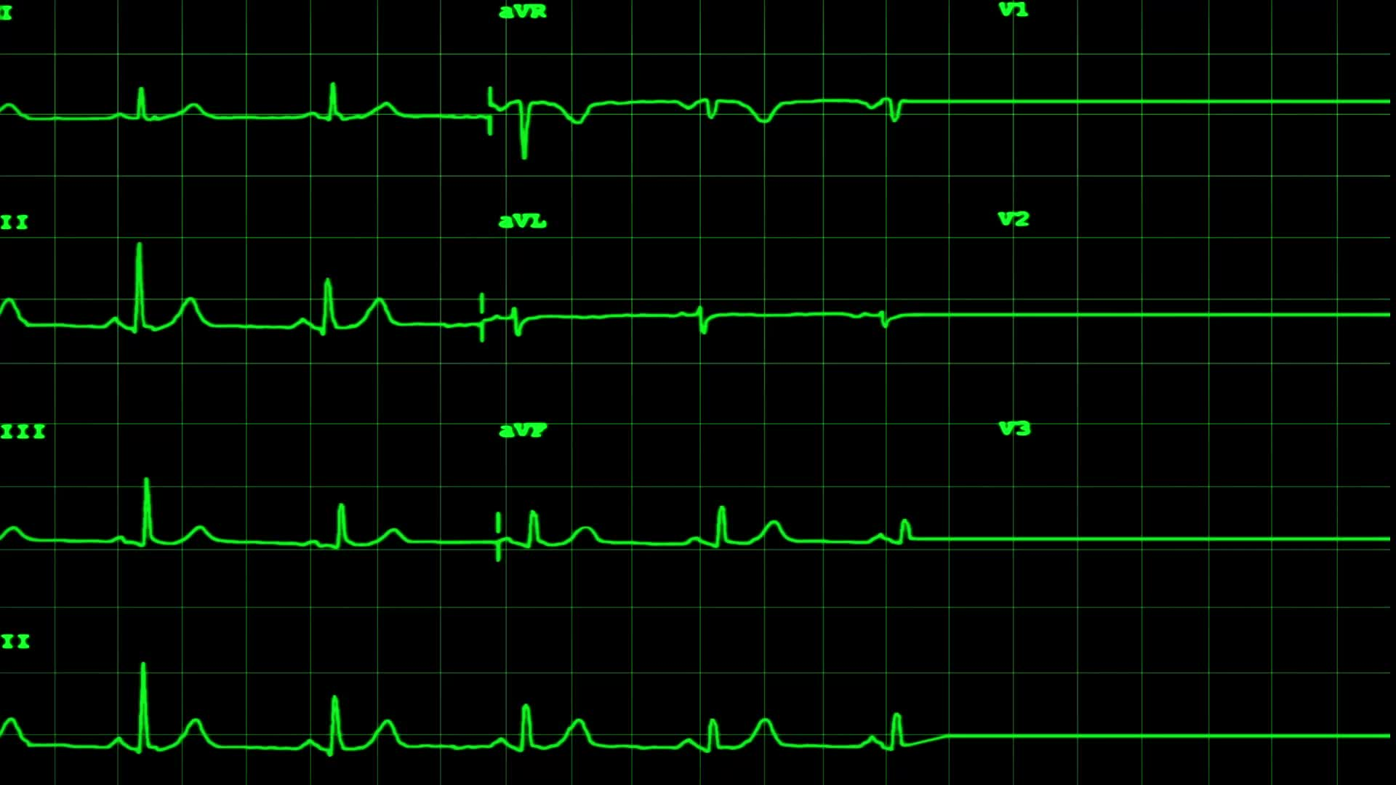
Unit 3
AOS 2:
Acute responses to exercise/activity
  02 deficit, uptake,
  VO2 max
  Responses of the muscular, respiratory, cardiovascular systems
Fatigue and recovery
  Fuel depletion
  Dehydration
  Accumulation of metabolic by products
  Thermoregulation
  Nutrition and hydration

Slide 14
AOS 2 Cont’d
Energy Systems
  ATP
  Fuels (chemical and food)
  Energy system characteristics
  ATP resynthesis
  Interplay of energy systems

Slide 15
Unit 4: Fitness Components and Training Programs
AOS 1:
Fitness Components
Activity analysis
Data collection styles and types
Skill frequency, movement patterns, work rest ratios
HR relation to intensity
Program planning
Fitness testing

Slide 16
AOS 2
Training programs
  Design and implement your own training program based off fitness testing results
  Monitor and record sessions
  Evaluation of program

Slide 17
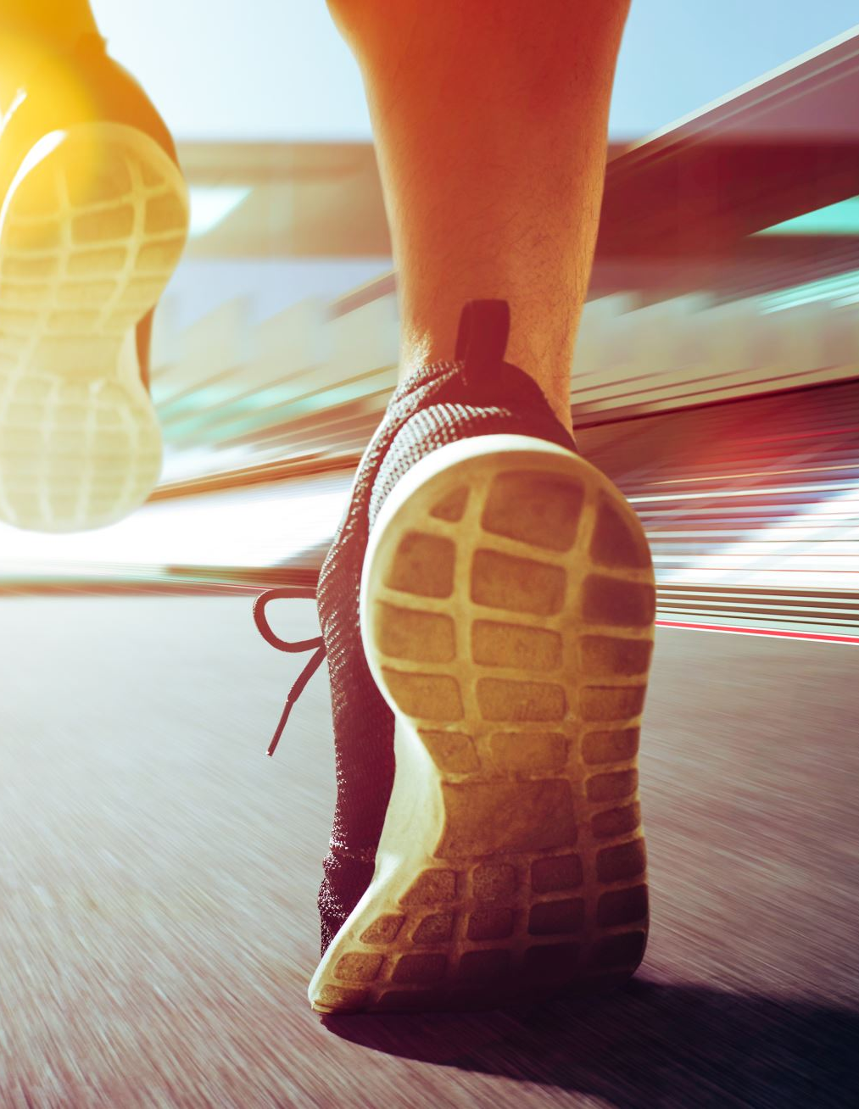
AOS 3
Integrated movement experience
  In this topic, you will not learn any new content; instead, you will apply the knowledge that you have already learned throughout the subject to refine your understanding of how the different aspects covered in the course combine to produce optimal sporting performance. You will complete;
  a practical activity focusing on a particular movement skill, the performance of which can be compared to another individual completing the same skill or
  a practical activity focusing on comparing your participation in two different movement skills.

Slide 18
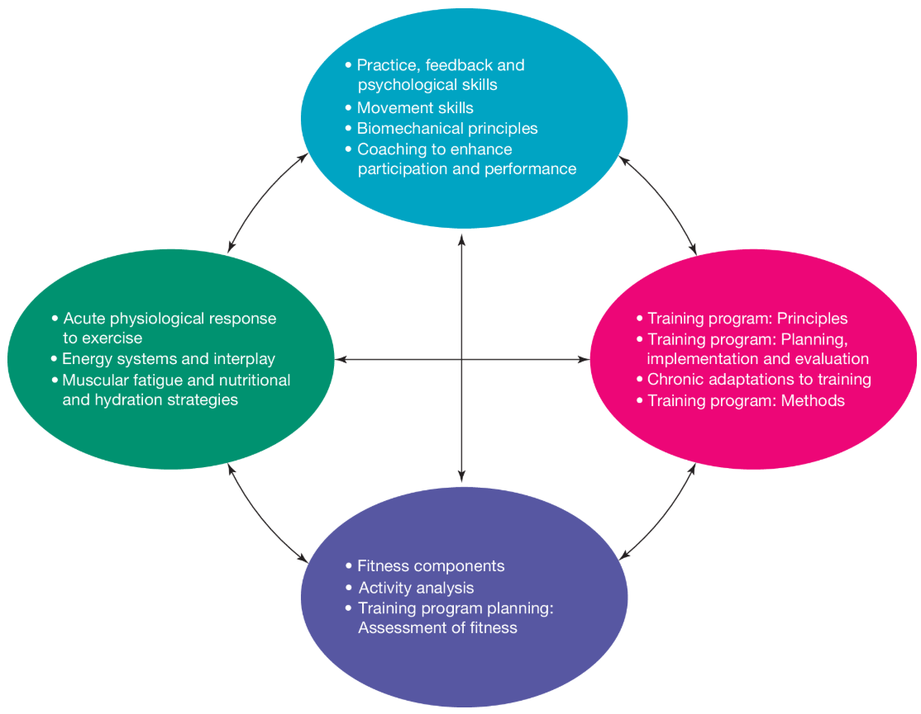
AOS 3

