Slide 1
Humanities
VCE

Slide 2
VCE Humanities year 11 2021
20th Century History
Business Management
Classics
Global Politics
Legal Studies
Philosophy

Slide 3
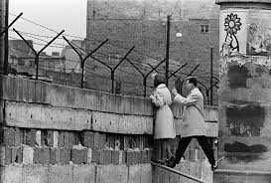
20th Century History
Rise of Fascism – Germany, Italy & Japan
USA in the 1920s & 30s- Jazz Age, Prohibition, Cinema, Wall St Crash, Great Depression
The Cold War- Arms Race, Berlin Wall, Cuban Missile Crisis, Vietnam War
South Africa- Struggle against Apartheid
Israel & the Arab world- an ongoing conflict

Slide 4




Business management
UNIT 1: PLANNING A BUSINESS
  The importance of business to a nation’s wellbeing
  Fostering innovation and entrepreneurship
  Business ideas and conditions for establishing a successful business
  Writing a business plan
UNIT 2: ESTABLISHING A BUSINESS
  Business logistics – staffing, establishing a customer base, legal requirements
  Marketing
  Management practices using contemporary business case studies

Slide 5
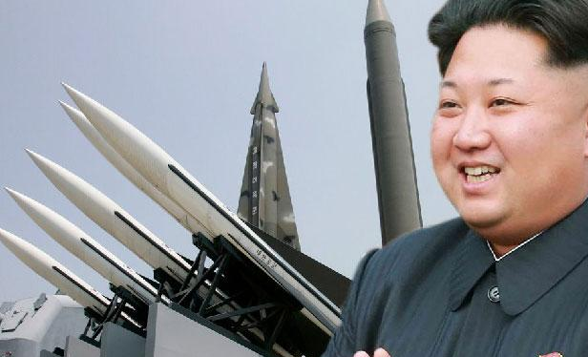
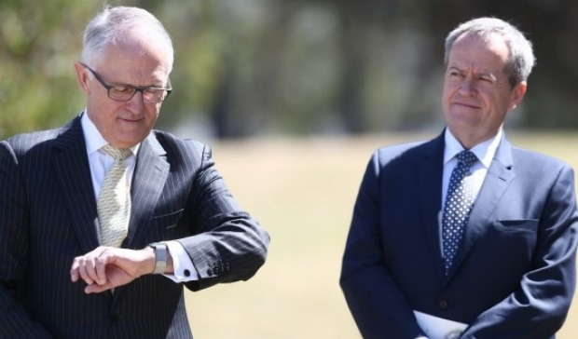
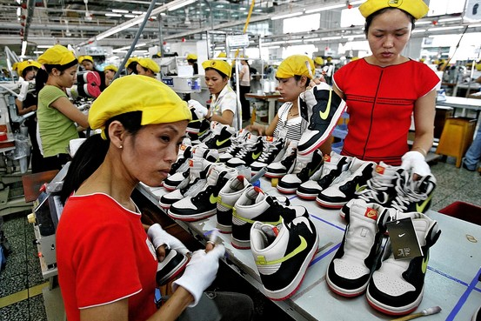
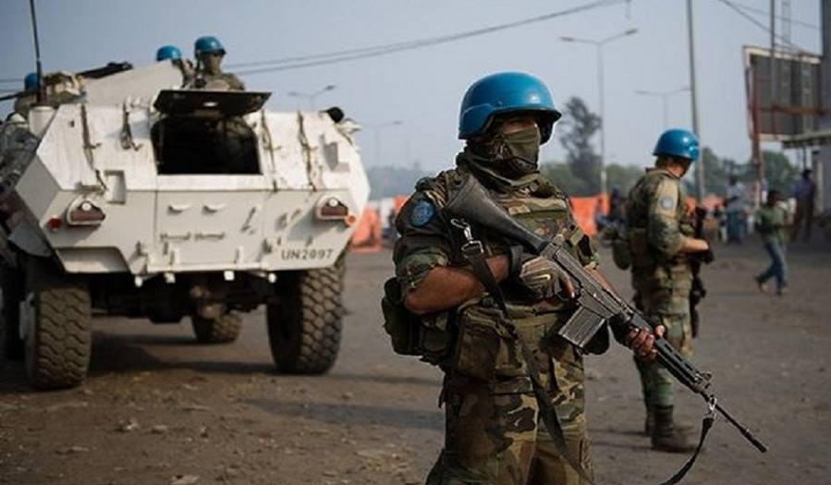
Australian & Global politics
Power & ideas
  What is power, how is it used & what is it used for?
Political actors
  Do political parties, interest groups or the media have more power?
Global links
  Who are the winners and losers from globalisation?
Global cooperation & conflict
  Can the world work together to solve modern challenges?

Slide 6
~PHILOSOPHY~
Philosophy is quite possibly the most exhilarating and provocative subject you will ever study. It will challenge the way you think about things, introduce you to new and fascinating ideas, it will bewilder you, frustrate you and inspire you. It will sharpen you, it will make you a better thinker, it will make you wiser and maybe ever a bit braver!
We will answer questions like this:
Could we be living in a virtual reality without even knowing it? And if we were, would it even matter?
Do we have free will or has everything we've ever done and ever will do already been pre-determined?
Is there an objectively true answer the question 'what is 2+2'? What about the question 'Should women earn as much as men?'
Is our justice system fair? What is a fair punishment anyway?
If someone invents bionic legs that make their wearer faster than the fastest runner in the world, should everyone be able to go get a pair?
What exactly is it that makes Donald Trump so bad at arguing?

Slide 7
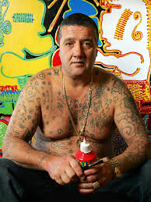
Legal studies
The Australian Legal System
CRIME - murder, manslaughter, assault, driving offences,
graffiti, theft, arson ….…
CIVIL DISPUTES – negligence, defamation…
SOLVE CRIMES – PROSECUTE THE BADDIES! TRY TO DEFEND THOSE ACCUSED OF CRIMES!
PUNISHMENT – deciding what to do with the convicted criminal
COMPENSATION – how to rake in 4.5 million bucks like Rebel Wilson did!!
RIGHTS – how does the legal system help us to exercise and protect our rights?
experiential!
visits to Parliament, Supreme & County courts, meet with a Judge, go to prison and speak to inmates

Slide 8
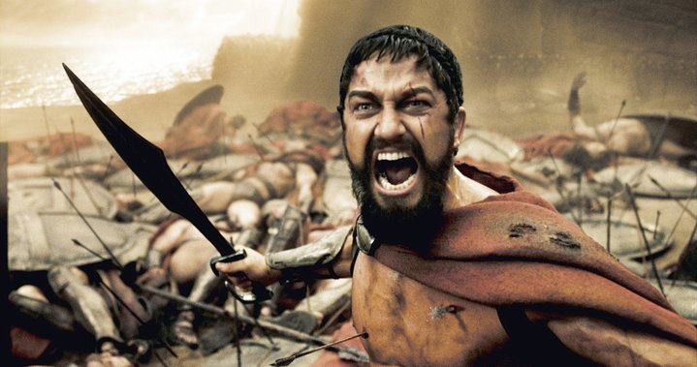
CLASSICAL STUDIES is the study of the classical Greece through a focus on: history, literature, archaeology, politics, philosophy and culture.
Questions we ask:
Why are the Greek myths full of heroes, jealous gods, revenge, lust, cannibalism?
Did Achilles, Heracles, Odysseus, Theseus and the minotaur exist?
Why is the Iliad the most famous literary work in the Western world?
What is the true story of the 300 Spartans?
Who was Oedipus?

